Slide 1


Slide 2
What is Amazon QuickSight ?
Amazon QuickSight
The most popular cloud-native, serverless BI service

Slide 3


Business Decisions ?

Slide 4

It’s Helps you

Slide 5


Asking questions in natural language

Slide 6


Slide 7
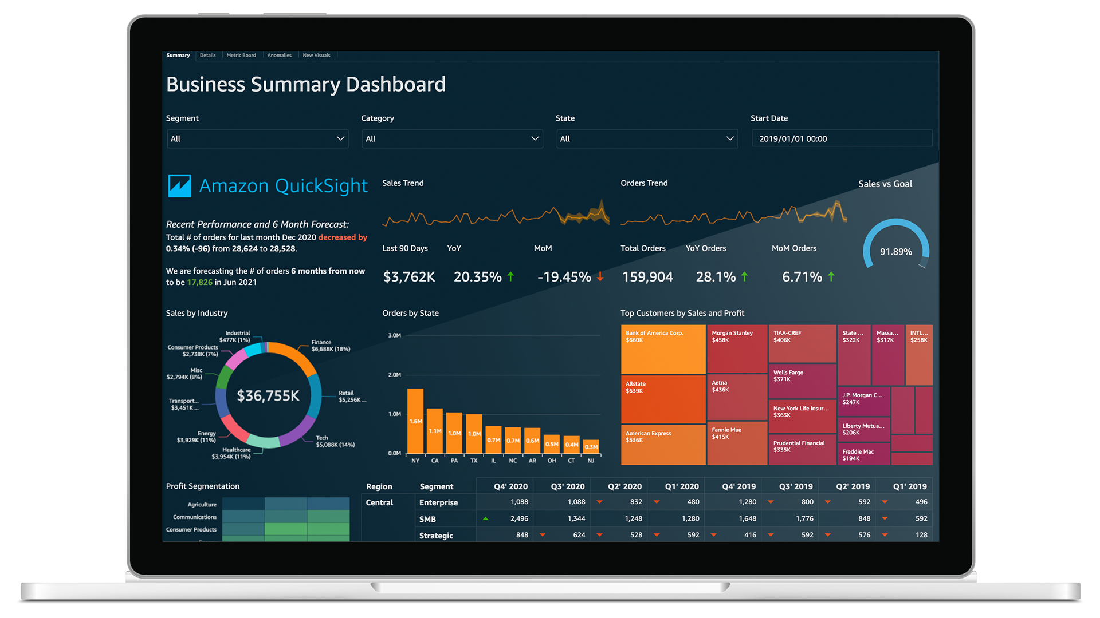
Interactive dashboards

Slide 8

Machine Learning for outliers and patterns

Slide 9


Slide 10
Thanks for watching

